Slide 1


Web Application to store and analyze green house gas emissions
Sabbir Ahmed -1930434
Syeda Afifa- 1730949
Tahmina Faruki Ria - 2222505
Isma Haider - 2220576
Noor -E-Kainat- 2010205

Slide 2
Business opportunities are like buses. There’s always another one coming.
AS IS -
“
”
Richard Branson

Slide 3
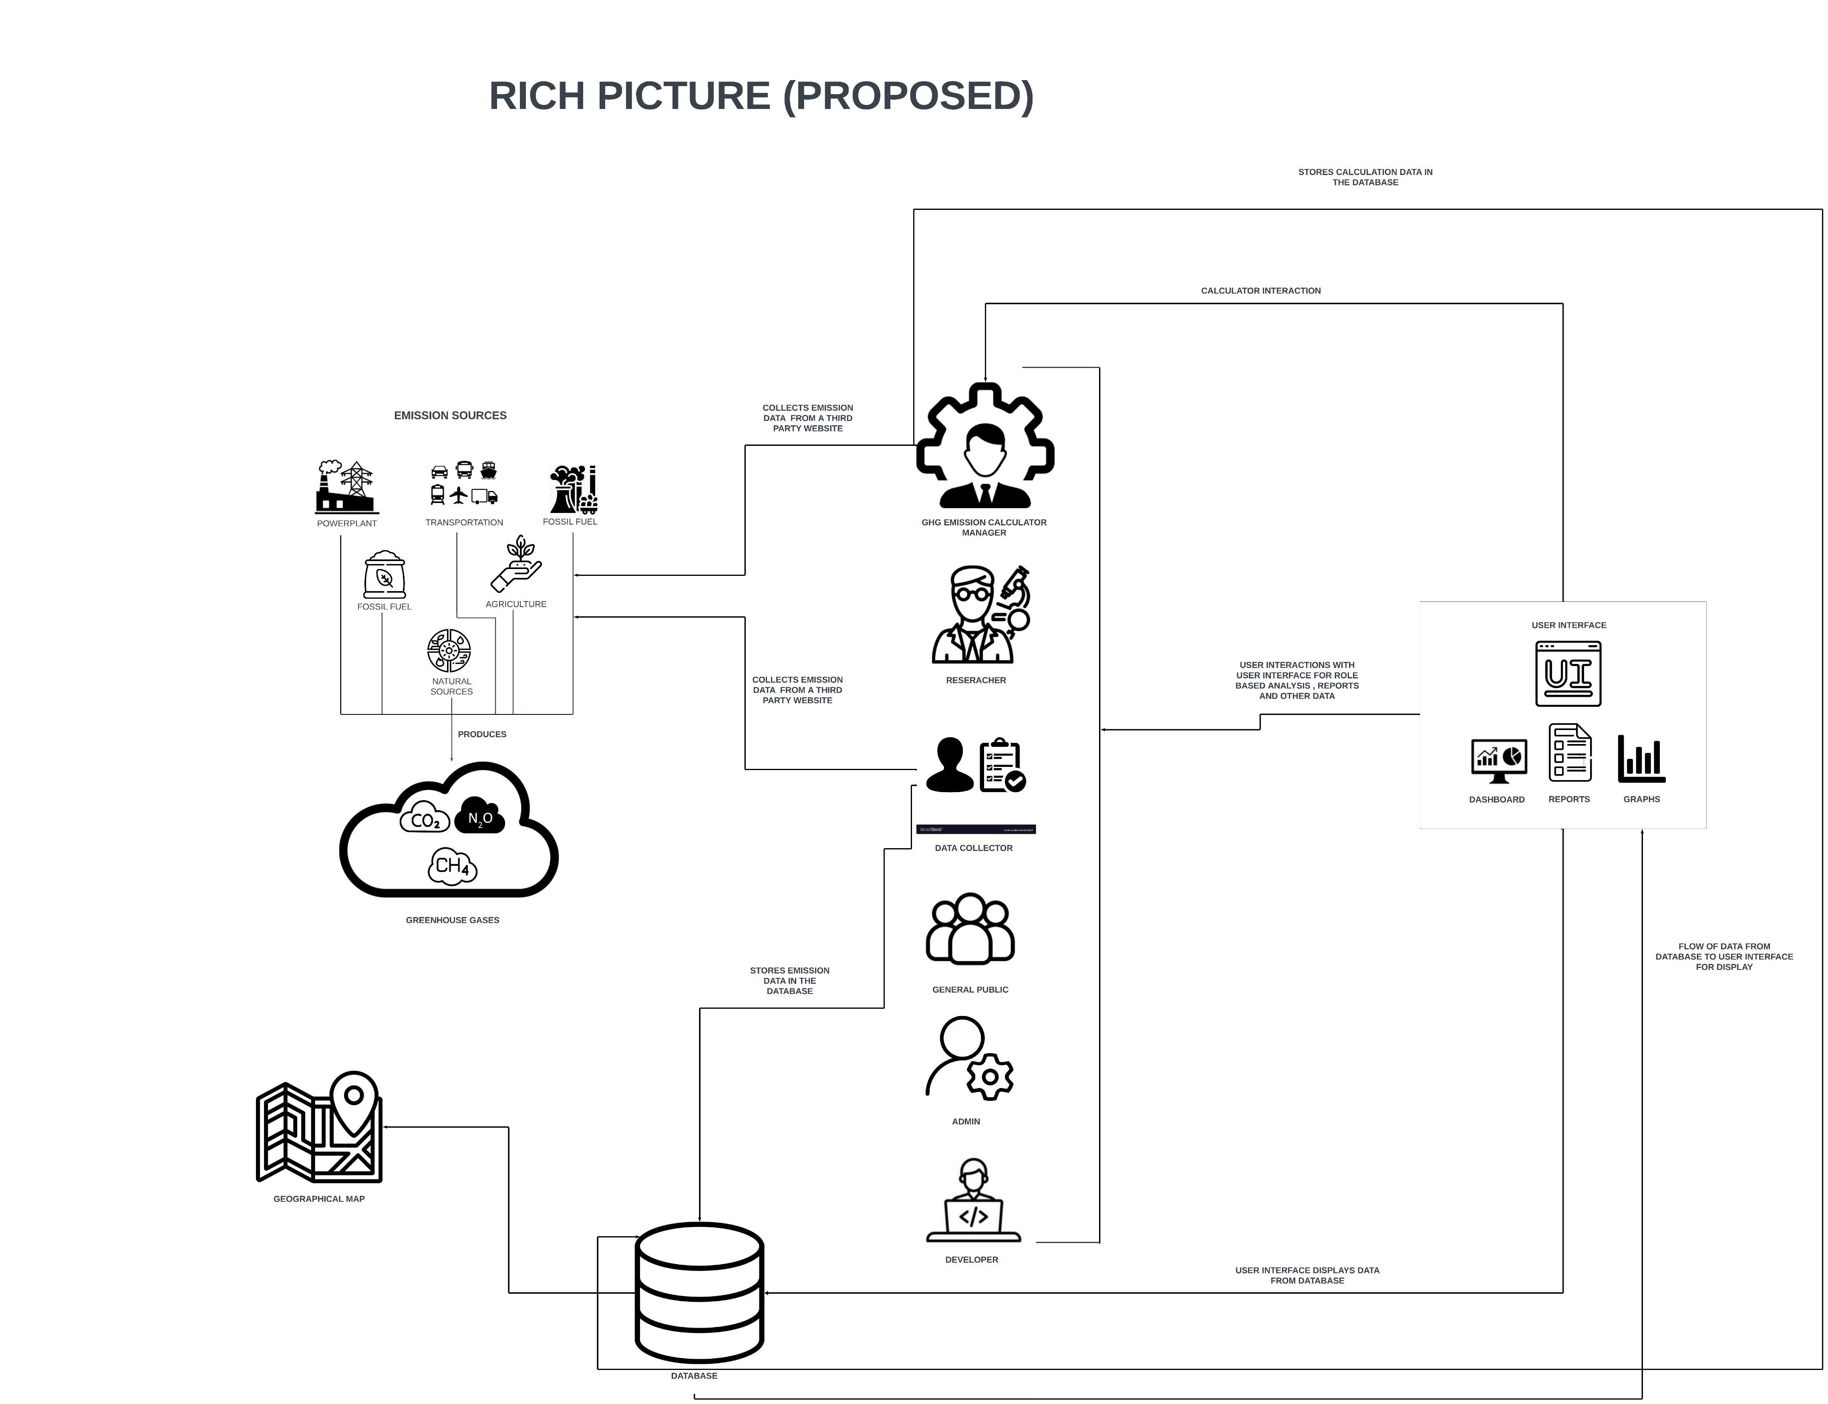

Slide 4
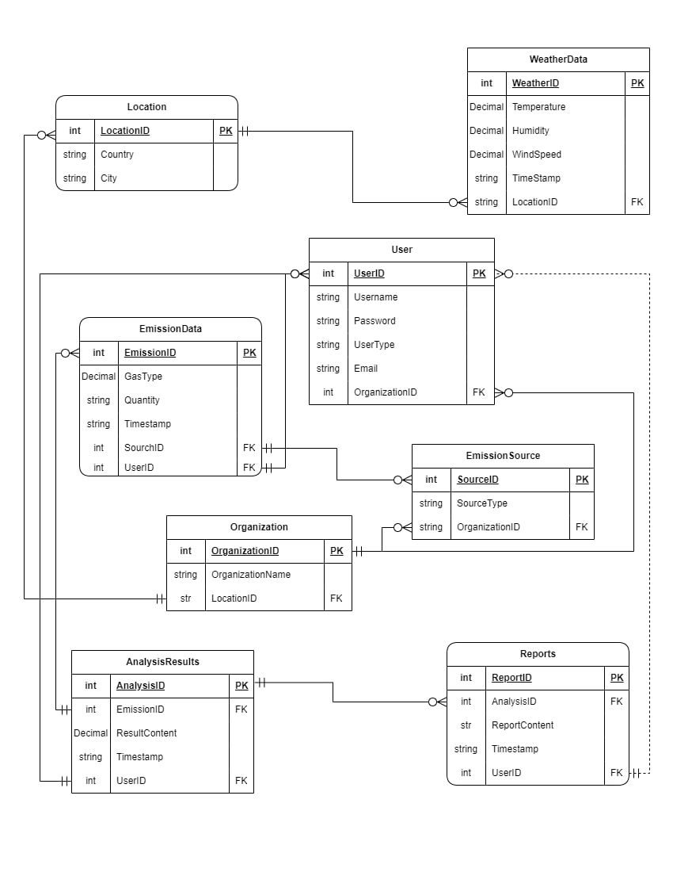
ENTITY RELATIONSHIP DIAGRAM

Slide 5
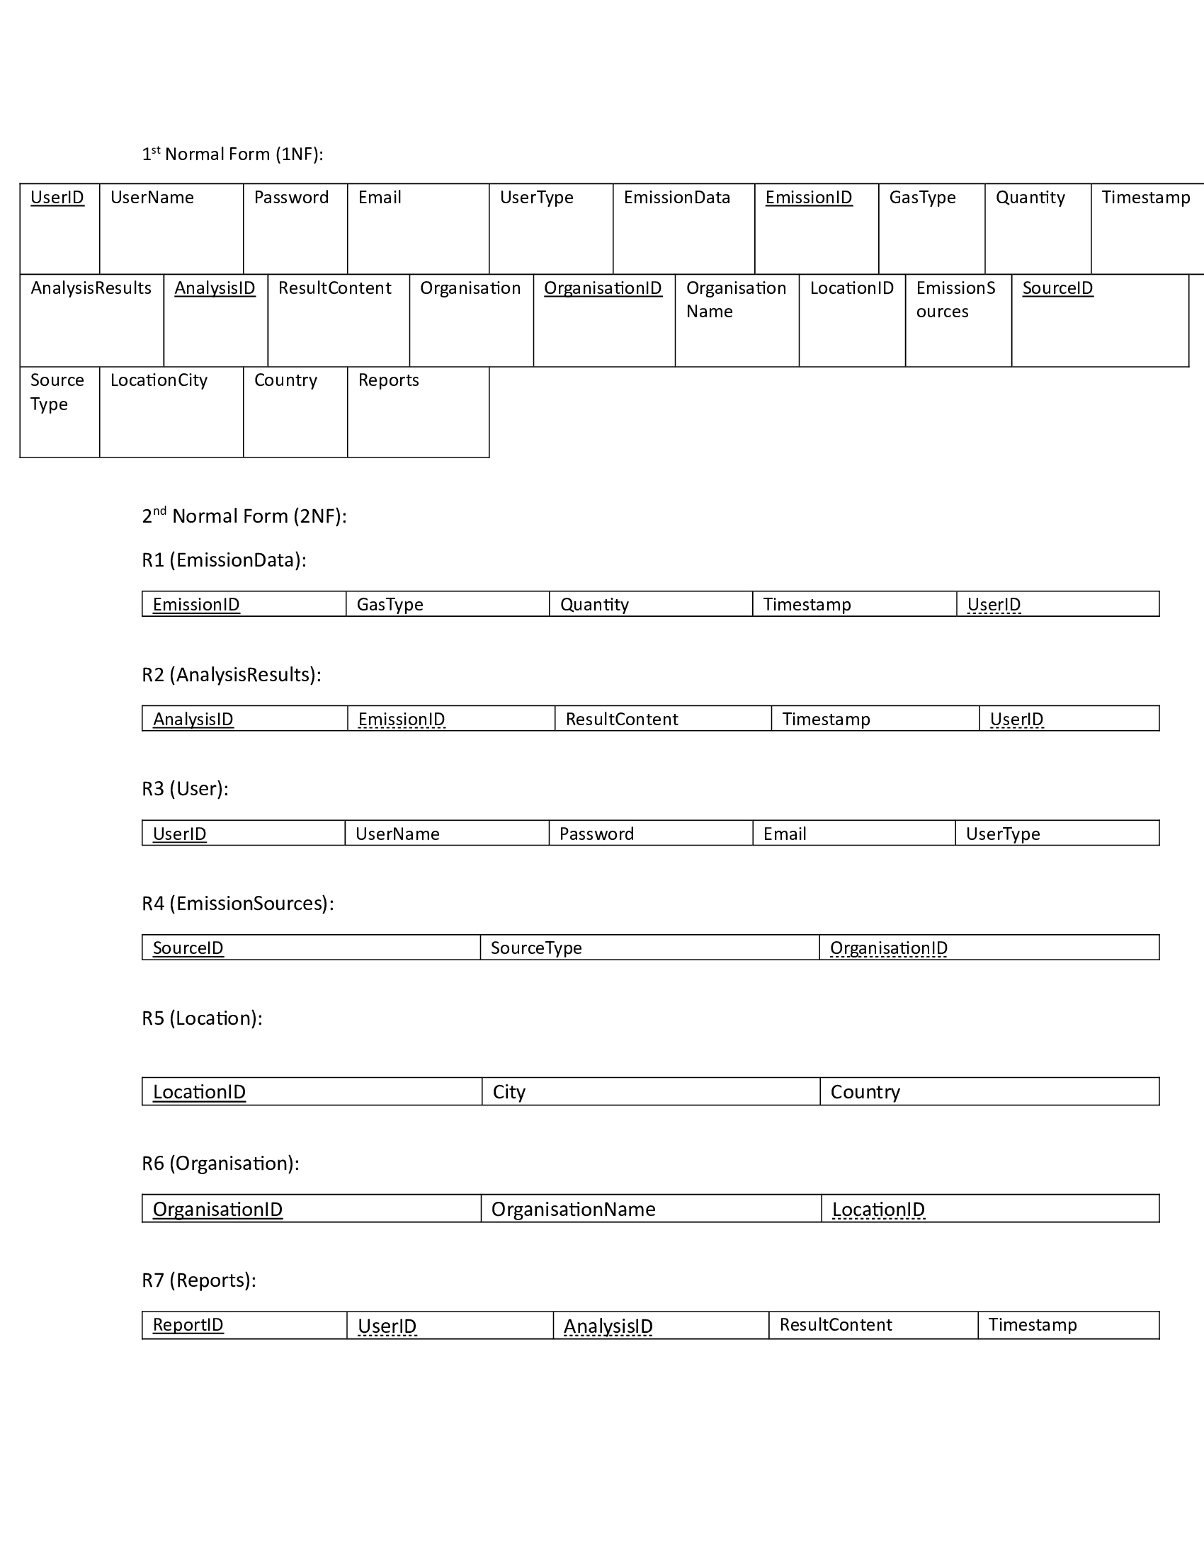
Normalization

Slide 6
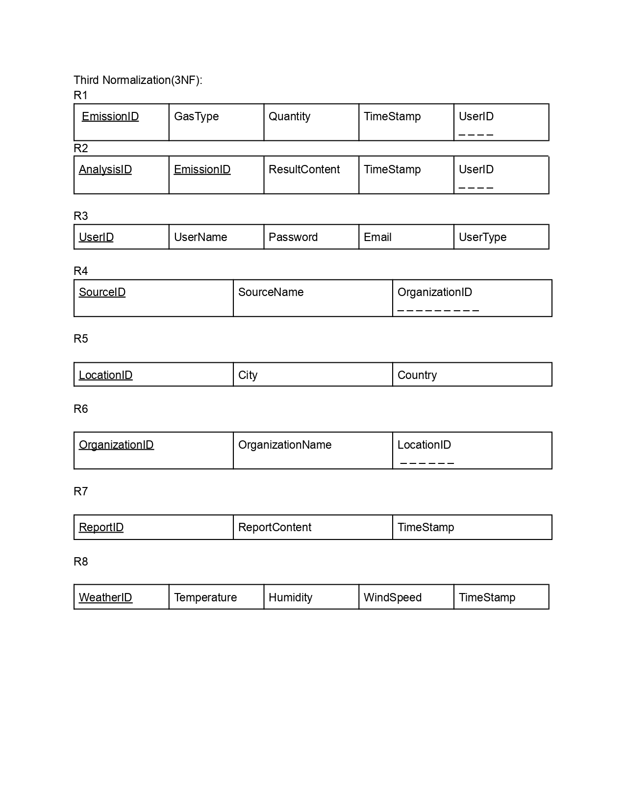

Slide 7
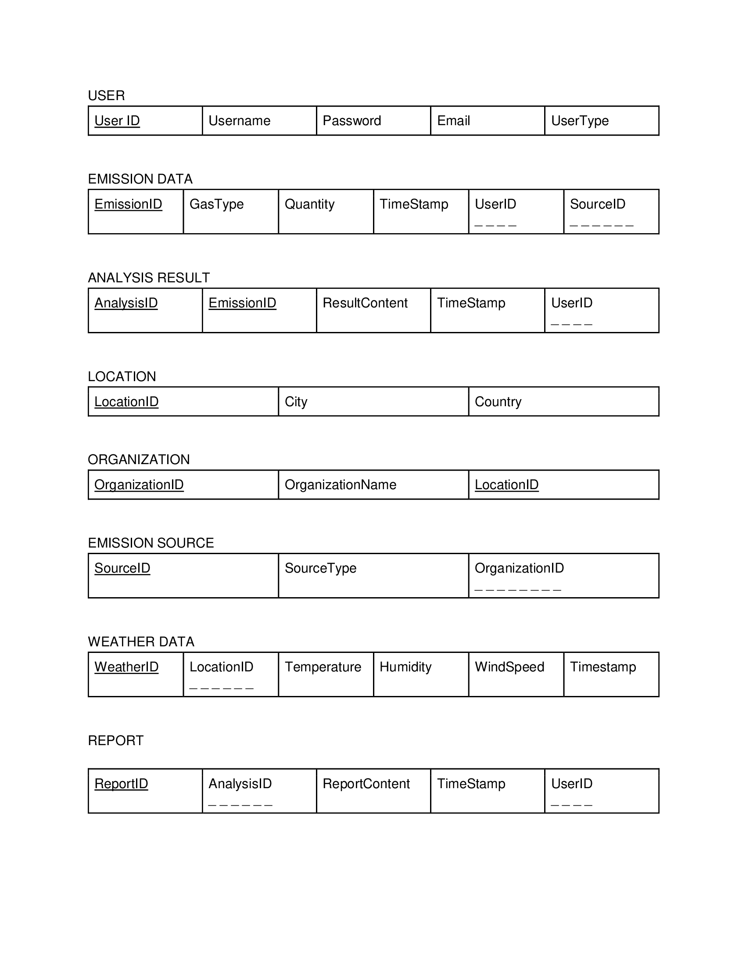
Areas of growth
RELATIONAL SCHEMA
 | B2B | Supply chain | ROI | E-commerce
Q1 | 4.5 | 2.3 | 1.7 | 5.0
Q2 | 3.2 | 5.1 | 4.4 | 3.0
Q3 | 2.1 | 1.7 | 2.5 | 2.8
Q4 | 4.5 | 2.2 | 1.7 | 70

Slide 8
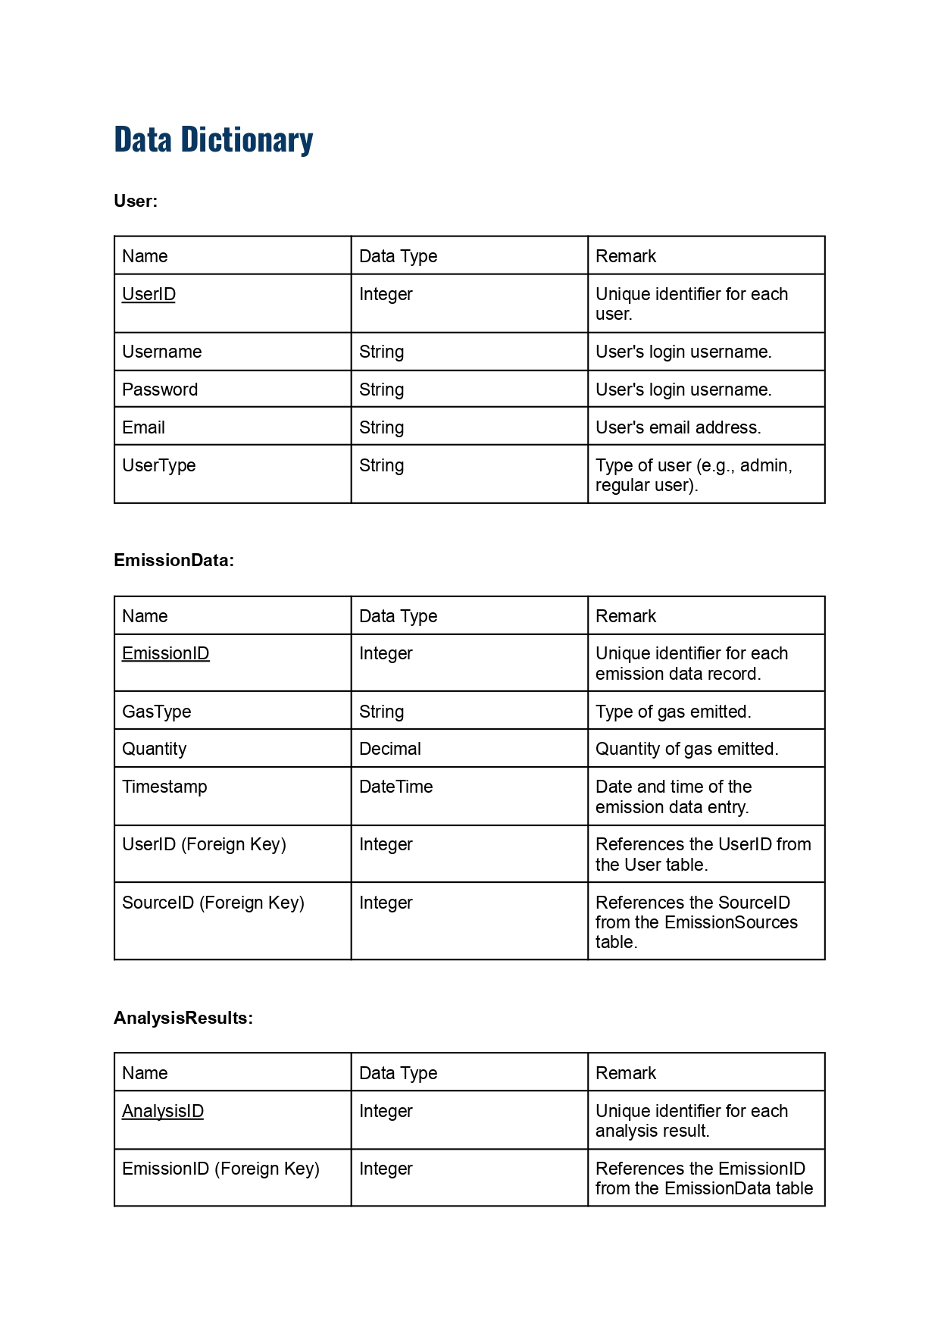
Timeline
Sep 20XX
Synergize scalable e-commerce
Jan 20XX
Coordinate e-business applications
May 20XX
Deploy strategy networks with compelling e-business needs
Nov 20XX
Disseminate standardized metrics
Mar 20XX
Foster holistically superior methodologies

Slide 9
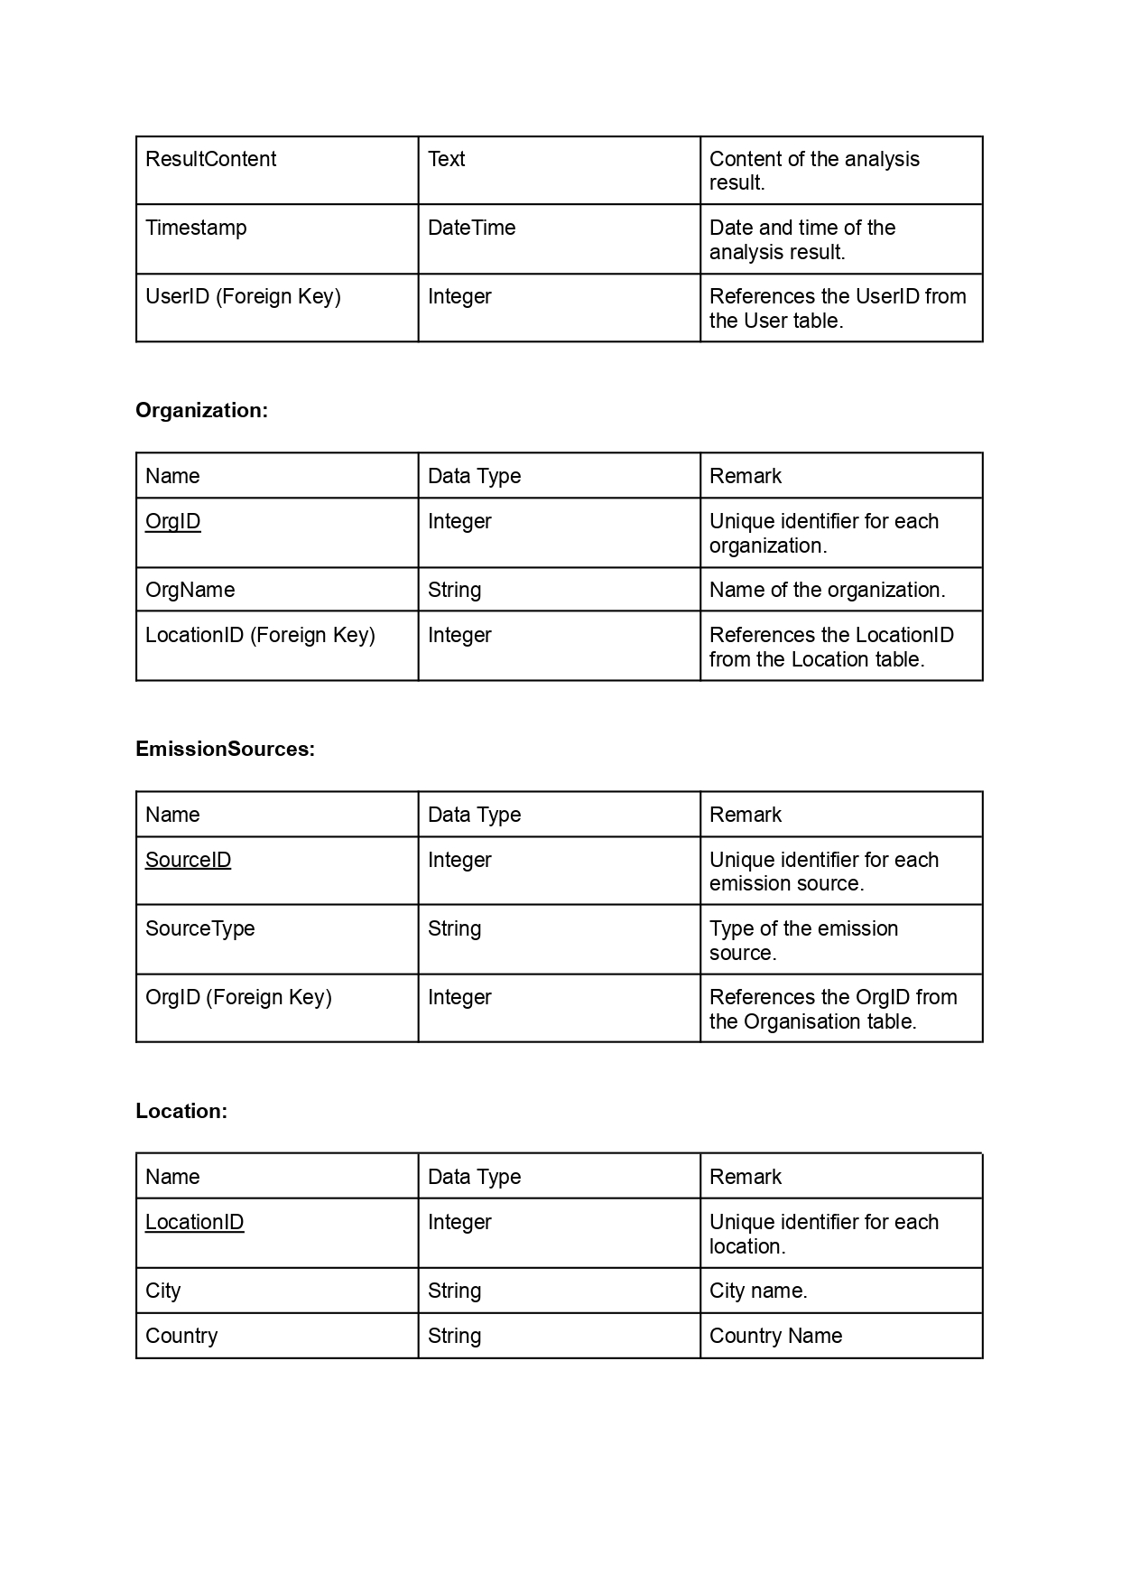
Timeline
Sep 20XX
Synergize scalable e-commerce
Jan 20XX
Coordinate e-business applications
May 20XX
Deploy strategy networks with compelling e-business needs
Nov 20XX
Disseminate standardized metrics
Mar 20XX
Foster holistically superior methodologies

Slide 10
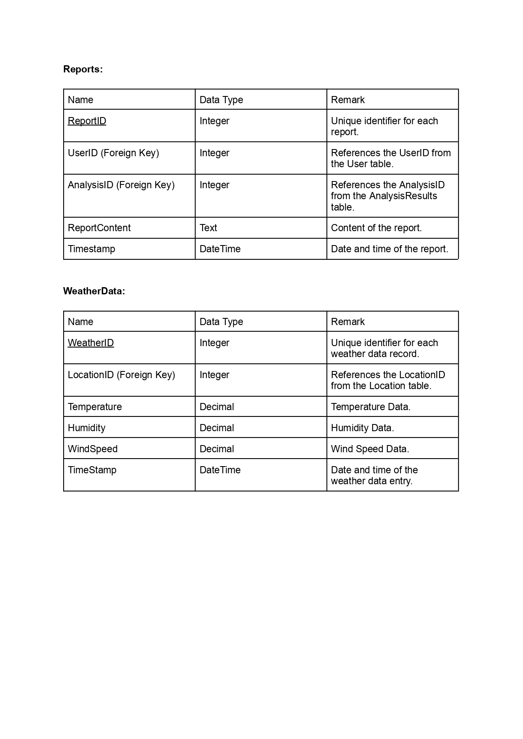
Timeline
Sep 20XX
Synergize scalable e-commerce
Jan 20XX
Coordinate e-business applications
May 20XX
Deploy strategy networks with compelling e-business needs
Nov 20XX
Disseminate standardized metrics
Mar 20XX
Foster holistically superior methodologies

Slide 11
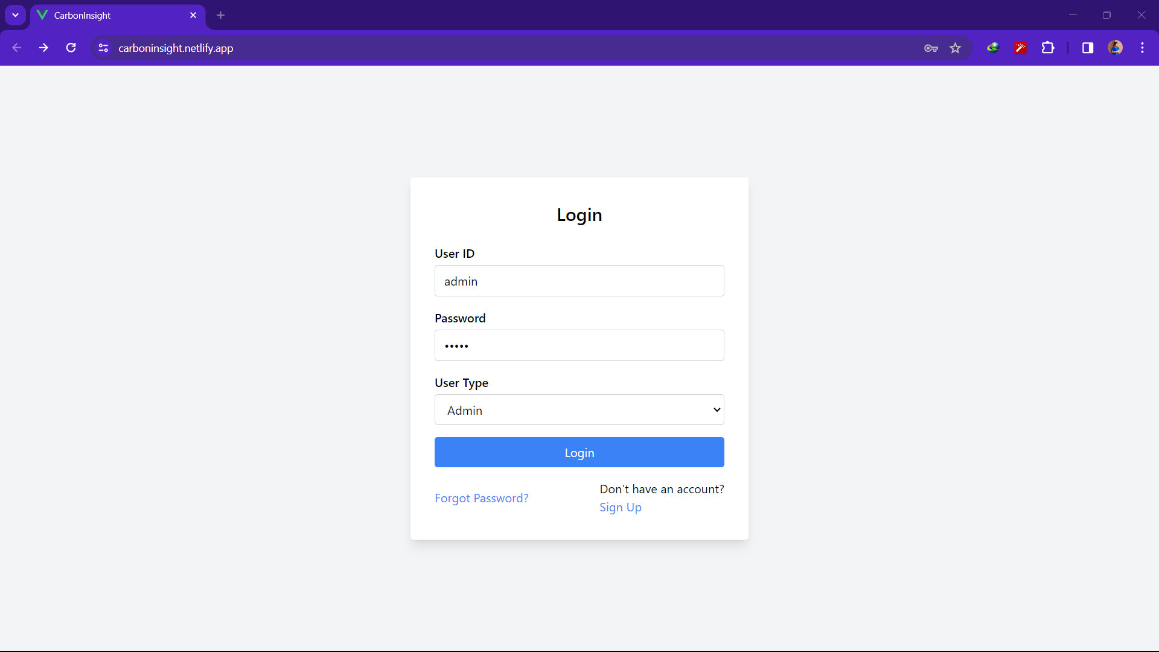
How we get there​
ROI​
Niche markets
Supply chains​
Envision multimedia-based expertise and cross-media growth strategies​ Visualize quality intellectual capital​ Engage worldwide methodologies with web-enabled technologies​ ​
Pursue scalable customer service through sustainable strategies​ Engage top-line web services with cutting-edge deliverables​
Cultivate one-to-one customer service with robust ideas​ Maximize timely deliverables for real-time schemas

Slide 12
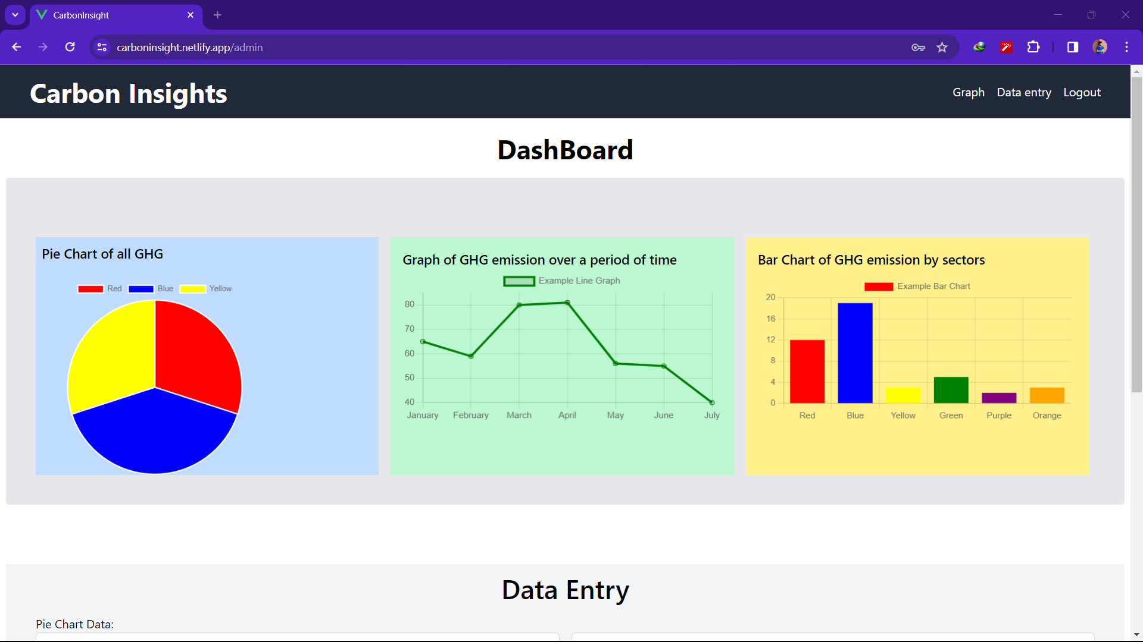





Plan for product launch
Planning
Synergize scalable e-commerce
Marketing
Disseminate standardized metrics
Design
Coordinate e-business applications
Strategy
Foster holistically superior methodologies
Launch
Deploy strategic networks with compelling e-business needs

Slide 13
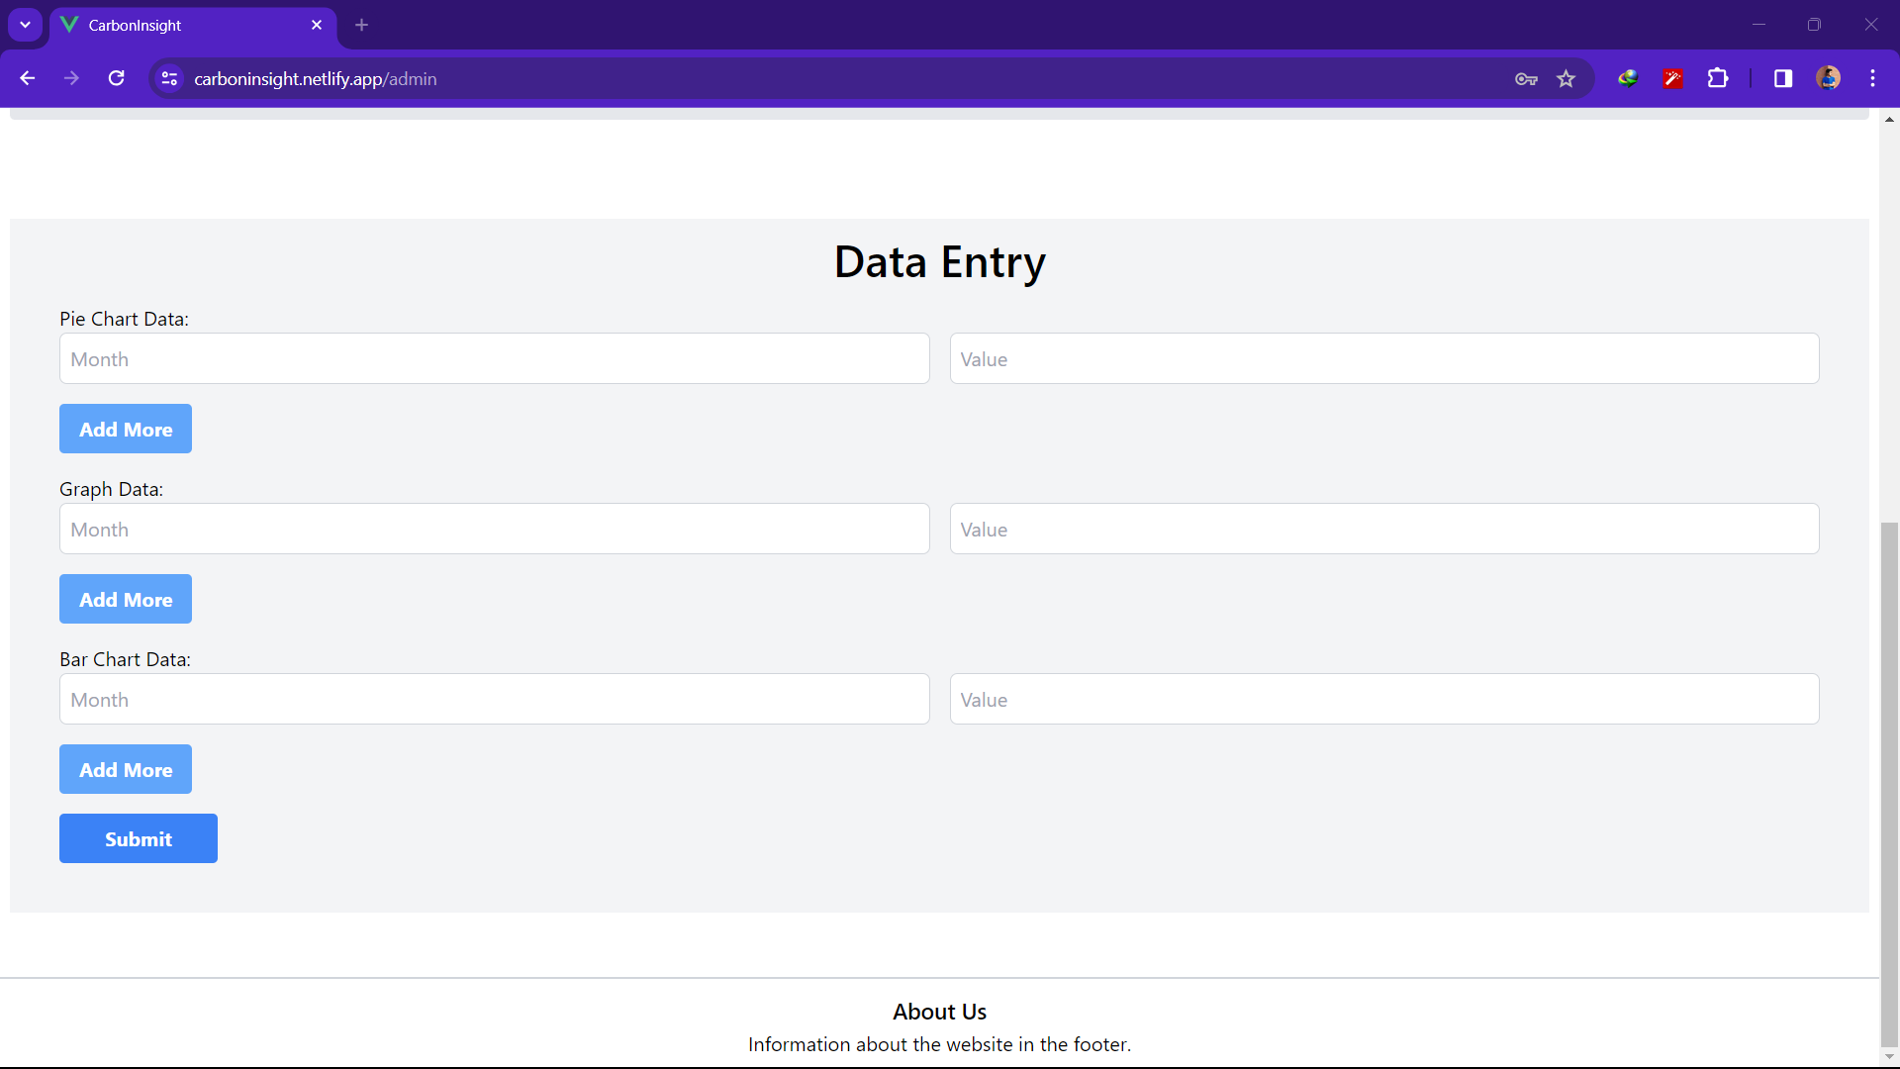








Meet our extended team
Takuma Hayashi
Mirjam Nilsson
Flora Berggren
Rajesh Santoshi
President
Chief Executive Officer
Chief Operations Officer
VP Marketing
Graham Barnes
Rowan Murphy
Elizabeth Moore
Robin Kline
VP Product
SEO Strategist
Product Designer
Content Developer

Slide 14
Thank you

